Slide 1

E-COMMERCE DASHBOARD
Project Report
Yash Khamitkar

Slide 2
Objective
To design a dashboard for an E-Commerce company which can help understand the trends of sales and profits.
To add a User Slicer for the product category and Monthwise.

Slide 3
Benefits
The dashboard will help company
Understand the trends of Monthly Sales and Profits.
Which region generates the maximum and minimum sales.
Which regions and product categories need to be focussed in order to boost the sales.
Distribution of orders in different age-groups.
Understand the trends of sales and profit monthly as well.

Slide 4
Problem Statement
An online e-commerce company's analytics team wants to create a sales dashboard to evaluate sales based on different product categories. The business aims to provide people more choice over product categories so they may choose one and can observe the trend month- and product-wise as appropriate.

Slide 5
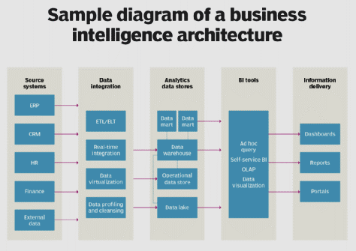
Architecture
Source: https://www.techtarget.com/searchbusinessanalytics/definition/business-intelligence-architecture

Slide 6
Dataset
The dataset of the e-commerce company is provided in the form of Excel workbook.
The dataset contains the following columns:
Order ID, Order Date, Ship Date, Aging, Ship Mode, Product Category, Product, Sales, Quantity, Discount, Profit, Shipping Cost, Order Priority, Customer ID, Customer Name, Segment, City, State, Country, Region, Months

Slide 7
Data Transformation
The dataset doesn’t have any null values and is clean. It is then used for analysis.
SUMIFS and Pivot Table function is used to calculate the sales, profit and quantity metrics.

Slide 8

Tool Used
Microsoft Excel is used to design the dashboard to gain insights about the sales and profits trends of the company.

Slide 9
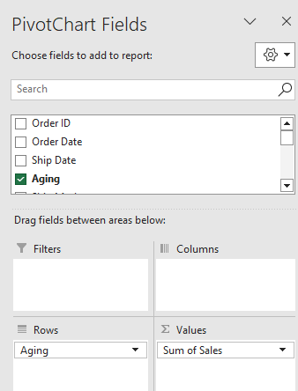
Steps to create Dashboard - 1
Step1: Create Pivot Table for Shipping Days(Aging)
To create pivot table, go to insert > pivot table>select table,
Selected the row as aging and value as sale
Analysis.
Now, In Pivotable Analyze select PivotChart and click OK insert charts dialog box will appear. Add the required chart.

Slide 10
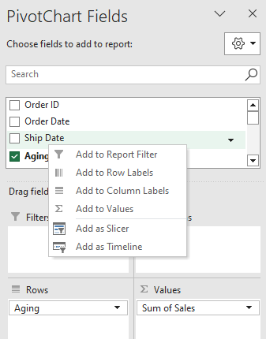
Steps to create Dashboard - 2
Step 2: Create Slicer
In PivotChart Fields right click to column click to add a Slicer that column will acts as Slicer.

Slide 11
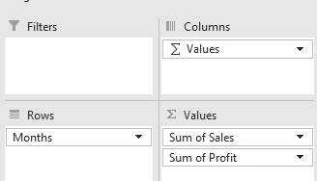
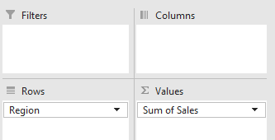
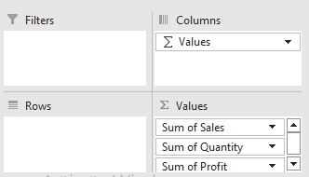
Steps to create Dashboard - 3
Create Different Pivot table as per your chart requirement
For Region wise Sales
Sum of Sales, Profit and Quantity
For Month wise Sales and Profit

Slide 12
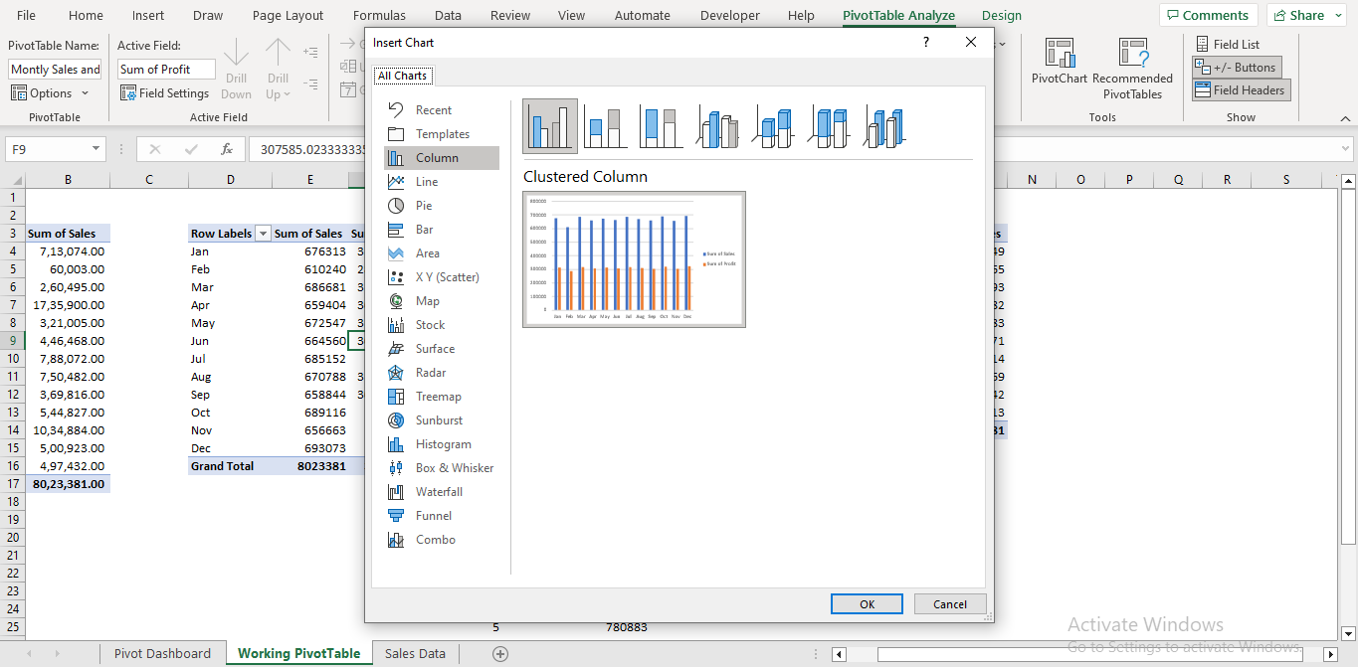
Steps to create Dashboard - 4
Now, In PivotTable Analyze select the PivotChart option and choice the appropriate chart
As per columns or requirement .

Slide 13
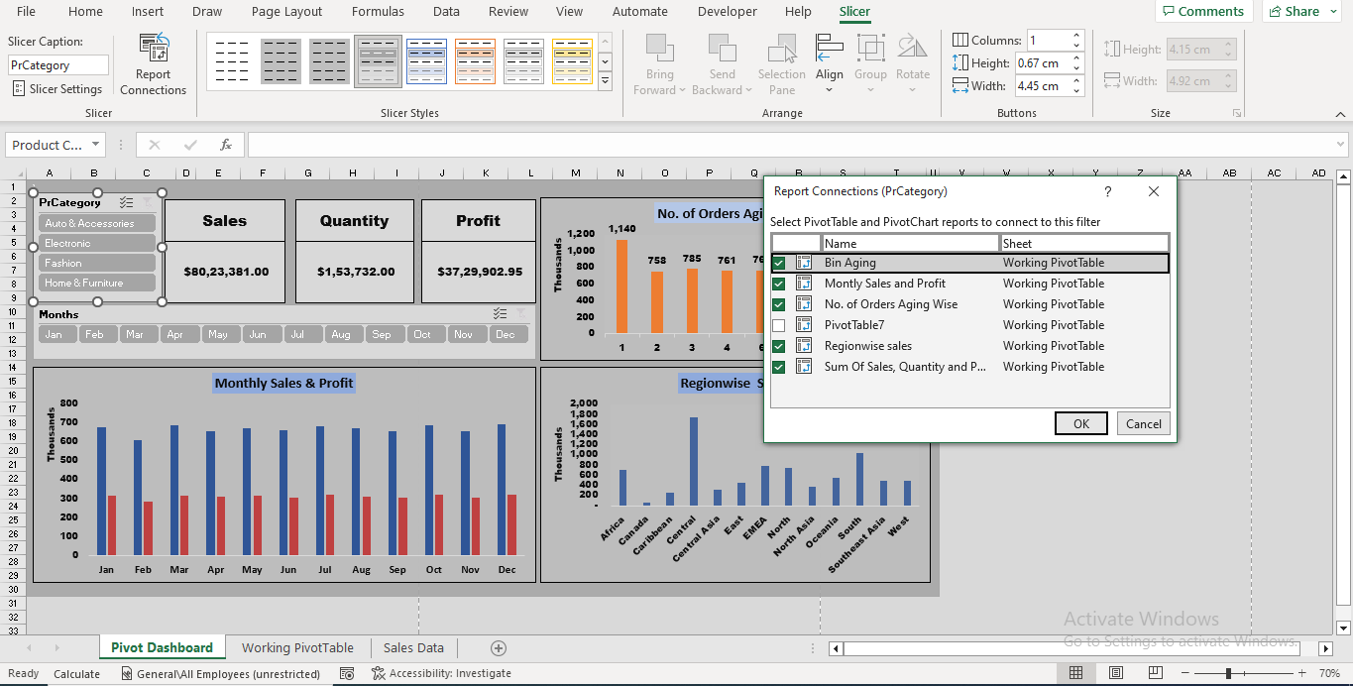
Steps to create Dashboard - 5
Step 5: Slicer
Now, Slicer connect to each Chart/Table to interact as per slicer selection.
In Slicer select Report Connections and
Dialog box opens check the PivotTable.
repeat same process for other slicers.

Slide 14
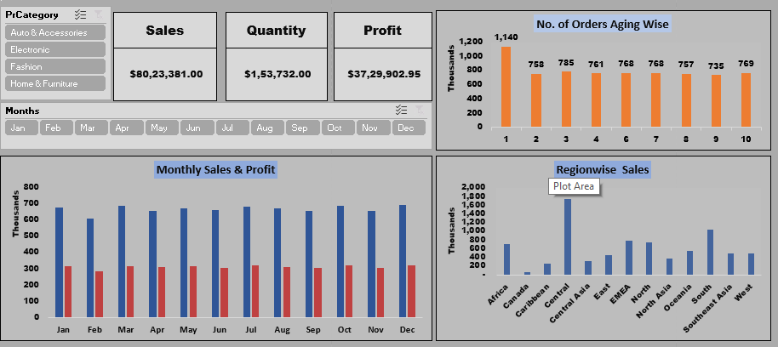
Dashboard

Slide 15
Insights
Electronics is the least-selling category and is preferred by age group 0-1 only.
The Central region generates the maximum sales for the company.
In categories other than the Electronics, the distribution of orders is almost similar for all the age groups.
The sales and profit trends for each category keeps on changing monthly.

